Slide 1
L10.04 Dynamic Programming
50.004 Introduction to Algorithm
Dr. Simon LUI
ISTD, SUTD

Slide 2
Objective
Dynamic programing: new technique for solving optimization problems
Understand why we use dynamic programming
Apply DP on many examples

Slide 3
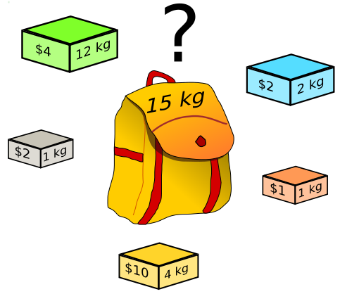
Google Interview Question 1
(We will discuss about these questions at week 11/12, when we have enough knowledge to solve them)
Ok, Simon is a robber, broke into a bank
Given a knapsack
He saw a lot of gold pieces of different size / value
How to maximize the total value he can get?
Greedy algorithm: NO (most people without training will choose this approach)
Dynamic Programming: YES

Slide 4
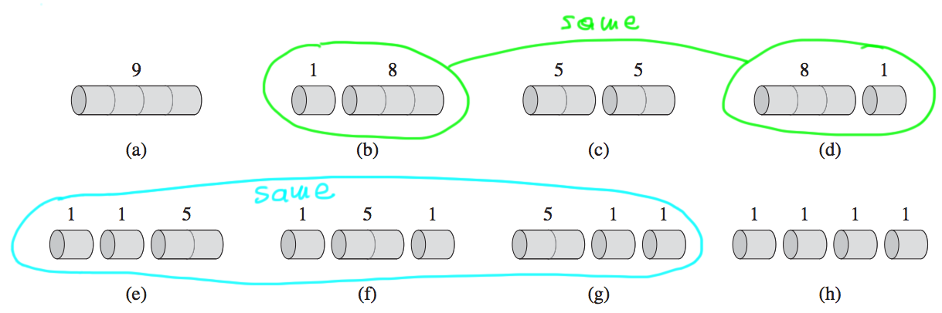
Google Interview Question 2
You have a piece of wood of length 30.
You cut them into pieces and sell them.
The market price is interest: length 30 = $30, size 15 = $20, size 10 = $5…. Etc.
How to maximize your earning?
Greedy algorithm: NO (most people without training will choose this approach)
Dynamic Programming: YES

Slide 5
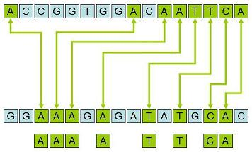
Dynamic Programming - Application
Longest common subsequence search
Text search
Query by humming
Situation awareness

Slide 6
Dynamic Programming - Application
Bellman Ford Algorithm
Dijkstra’s Algorithm
If sub path is optimal, then the full path is also optimal
Latex system
Calculate the space, hyphenation…

Slide 7
What is dynamic programming?
“Programming”: use a tabular method to solve problems by solving sub-problems
Use divide-and-conquer: recursion (sub-problems)
Sub-problems overlap: solve them only once!
DP = recursion + re-use
Table of
sub-problem
solution

Slide 8
Example 1 – Fibonacci number

Slide 9
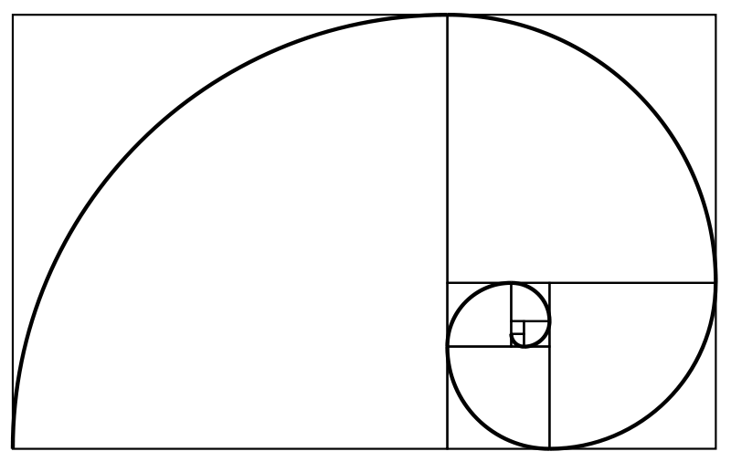
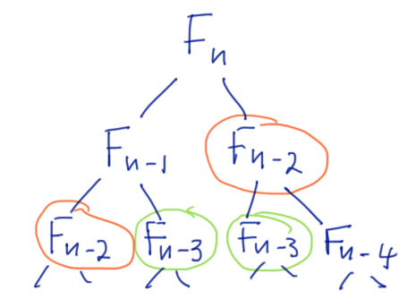
Fibonacci numbers
Naïve algorithm
Can we avoid the exponential cost?
Notes:
Lets make them think!

Slide 10
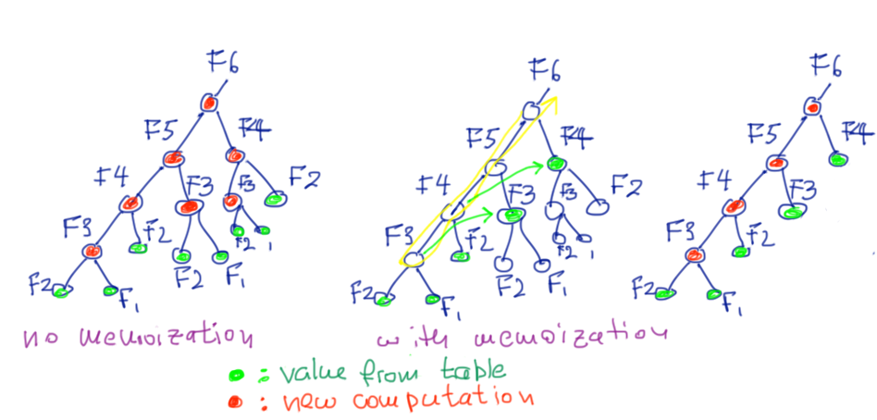
Memoization
Store values of sub-problems in table, to avoid computing them twice
Complexity: Θ(2^{n})!!!
Complexity: Θ(n)!!!

Slide 11
Fibonacci numbers
Memoized DP algorithm
Naïve algorithm
Notes:
Lets make them think!

Slide 12
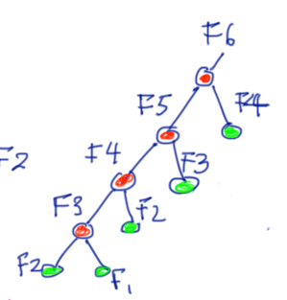
F_{k} will be invoked only twice:
first invocation: recursed
second invocation: memoized
=> Θ(n) total time
DP: recursion + memoization (reuse)
memoize: remember and re-use solutions
to sub-problems that are needed to
solve the problem
Fibonacci: F₁, F₂, F₃, …, F_{n}
Notes:
Fn-3: …
Each sub-problem is solved only
How about going bottom-up? reverse the sequence? came computations!

Slide 13
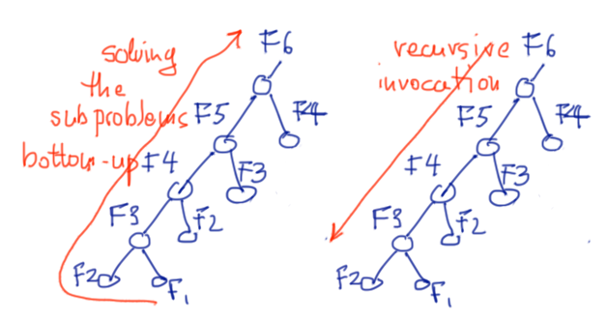
Bottom-up method:
Solve sub-problems in a “causal” sequence
from smaller to larger
Notes:
keep causality in the sequence

Slide 14
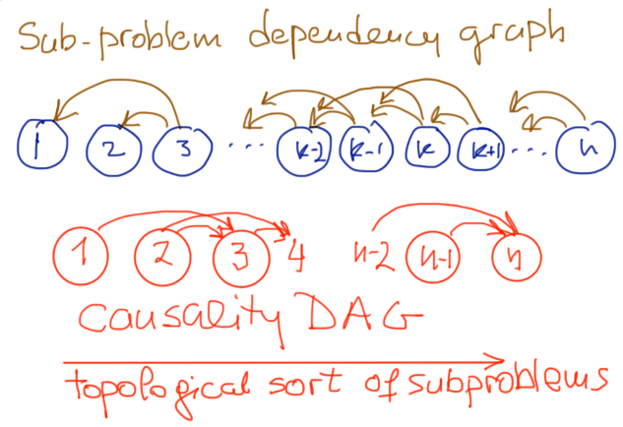
Bottom-up DP algorithm
Exactly the same computation as memoized DP (recursion rolled back)
In general: topological sort of sub-problem dependency graph => needs DAG structure!!
Practically faster (no recursion)
Can save space (just remember last 2 values) => Θ(1) space
Notes:
Do we know of problems without a DAG structure?

Slide 15
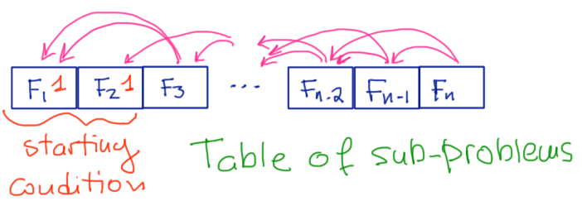
Bottom up: filling-in a table
Fill-in the table of sub-problems
Obey the dependency ordering
Table of sub-problems
Note: no circular dependency between sub-problems

Slide 16
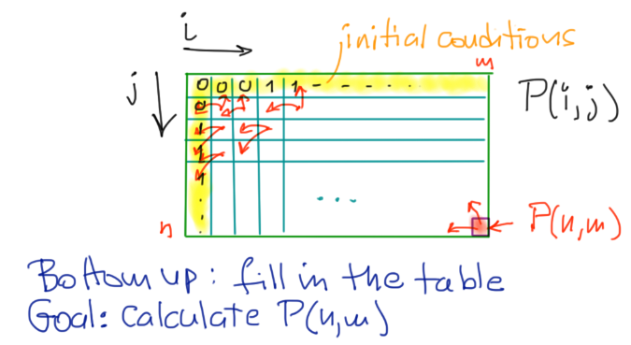
Bottom up: filling-in a table
Example with 2 dimensions
sub-problem is P(i, j), hence 2-d table
We need no circular dependency between sub-problems

Slide 17
Dynamic Programming definition
DP ≈ Recursion + Memoization
DP works when:
the solution can be produced by combining solutions of sub-problems
the solution of each sub-problem can be produced by combining solutions of sub-sub-problems, etc
no circular dependency
moreover….
the total number of different sub-problems arising recursively is polynomial

Slide 18
Dynamic Programming definition
DP ≈ Recursion + Memorization
DP works when:
the solution can be produced by combining solutions of sub-problems
the solution of each sub-problem can be produced by combining solutions of sub-sub-problems, etc
no circular dependency
moreover….
the total number of different sub-problems arising recursively is polynomial
Optimal substructure
The solution to a problem can be obtained by solutions to sub-problems with no circular dependency
Overlapping subproblems
A recursive solution contains a “small” number of distinct sub-problems (repeated many times)

Slide 19
Example 2 – shortest path

Slide 20
Shortest paths (single source)
Input: Directed graph G = (V, E), where |V | = n, with edge-weight function w : E → R
Output: 1 × n matrix of shortest-path lengths δ(s, j), j ∈ V, for a give source s
Assumption: No negative-weight cycles

Slide 21
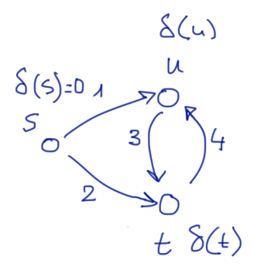
Example:
1. Write the DP equations for shortest paths from s

Slide 22
What we learned: to solve a problem using DP we need
the sub-problem structure to be a DAG
Some problems require a transformation to be solvable
by DP: rewrite them so that there is no cycle in sub-problems
Notes:
if no negative cycles

Slide 23
What we learned: to solve a problem using DP we need
the sub-problem structure to be a DAG
Some problems require a transformation to be solvable
by DP: rewrite them so that there is no cycle in sub-problems
constraint
Notes:
Constraint: in general higher cost, dropping with k
Give example

Slide 24
What we learned: to solve a problem using DP we need
the sub-problem structure to be a DAG
Some problems require a transformation to be solvable
by DP: rewrite them s.t. there is no cycle in sub-problems
Question:
The time complexity is ?
A. Θ(|V|²), B. Θ(|V||E|), C. Θ(|E|)
Notes:
How far we need to run it?

Slide 25
What we learned: to solve a problem using DP we need
the sub-problem structure to be a DAG
Some problems require a transformation to be solvable
by DP: rewrite them s.t. there is no cycle in sub-problems
Time:
|V||V|x Θ(in-degree(V))
= Θ(|V||E|) = Bellman-Ford
Notes:
if no negative cycles
When k increases, δ increases since I offer more flexibility

Slide 26
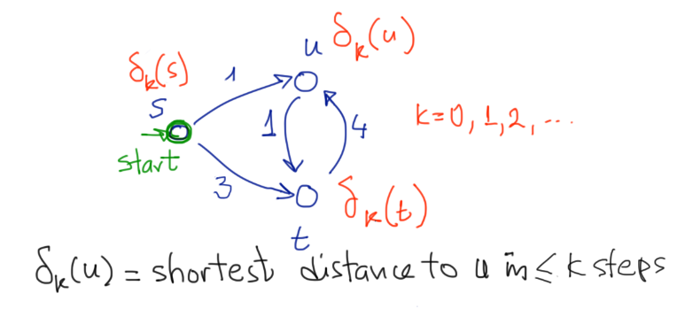
2. Now, Let’s solve the equations

Slide 27
 | s | u | t
k=0 | 0 | infty | infty
k=1 | 0
k=2 | 0
k=3 | 0

Slide 28
 | s | u | t
k=0 | 0 | infty | infty
k=1 | 0 | 1 | 3
k=2 | 0 | 1 | 2

Slide 29
 | s | u | t
k=0 | 0
k=1 | 0
k=2 | 0
+1
+3
+4
1
+1
3
Θ(|E|) ops per row
1
2
Notes:
Canonical structure to fill in elements of the table

Slide 30
Something more

Slide 31
Not all problem can be solved by DP
Consider the problem of maximum simple path from s to t
Question: Can we decompose it as a DP problem? E.g.
1
s
1
u
1
1
1
1
1
v
1
t

Slide 32
No.
In longest paths: sub-problems are not independent
the solution of one constrains the solution of the other
What we learned: for DP we need the following properties:
The problem must exhibit optimal substructure
The sub-problems must be independent

